Slide 1
Lecture 12
Graphs and graph search
EECS-214

Slide 2
Graphs
Informally, a graph is a network of objects connected by lines or arrows
The objects are called nodes or vertices and the lines are called edges

Slide 3
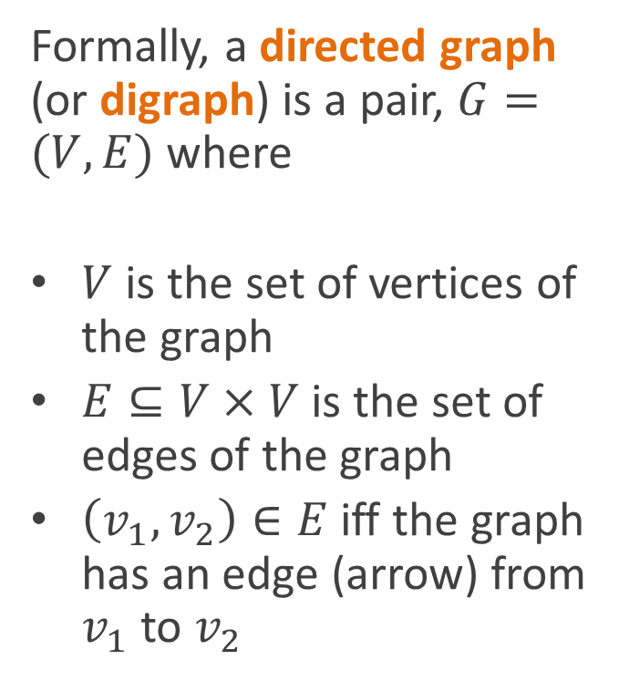
Graphs
Formally, a directed graph (or digraph) is a pair, $G=(V,E)$ where
$V$ is the set of vertices of the graph
$E⊆V×V$ is the set of edges of the graph
$\left(v_{1}, v_{2}\right)∈E$ iff the graph has an edge (arrow) from $v_{1}$ to $v_{2}$
Note: you can also think of a digraph as a relation on the vertices

Slide 4
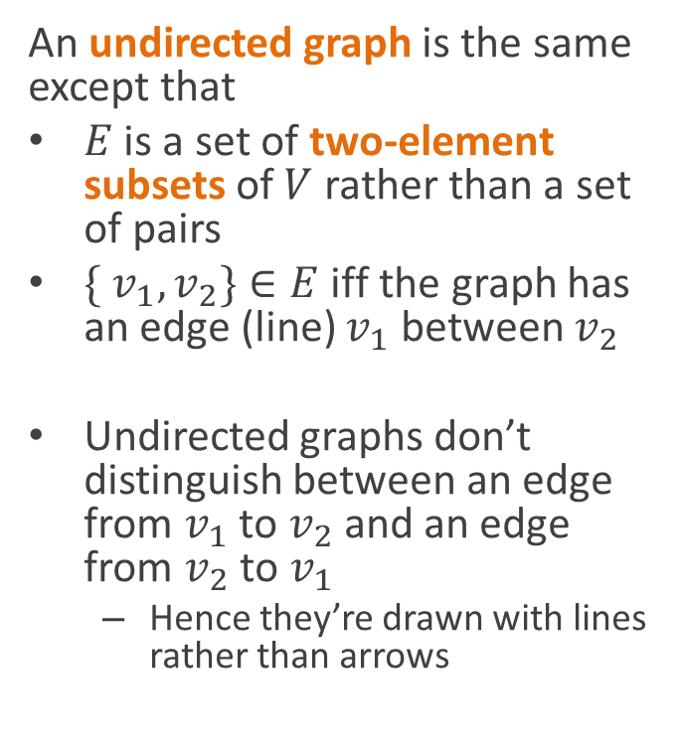
Graphs
An undirected graph is the same except that
$E$ is a set of two-element subsets of $V$ rather than a set of pairs
$\{ v_{1}, v_{2}\}∈E$ iff the graph has an edge (line) $v_{1}$ between $v_{2}$
Undirected graphs don’t distinguish between an edge from $v_{1}$ to $v_{2}$ and an edge from $v_{2}$ to $v_{1}$
  Hence they’re drawn with lines rather than arrows
Note: you can also think of an undirected graph as a symmetric relation on the vertices

Slide 5
Subgraphs
A subgraph is just a subset of the vertices and/or edges of some other graph

Slide 6
Subgraphs
A subgraph is just a subset of the vertices and/or edges of some other graph

Slide 7
Subgraphs
A subgraph is just a subset of the vertices and/or edges of some other graph

Slide 8
Subgraphs
A subgraph is just a subset of the vertices and/or edges of some other graph

Slide 9
Connectivity
Two vertices linked by an edge are said to be adjacent

Slide 10
Paths
A path is a series of adjacent vertices that doesn’t repeat the same vertex
  For a directed graph, the path has to follow the direction of the edges
Two vertices are connected, if there is a path between them

Slide 11
Connectivity
A graph is connected if every vertex in the graph is connected to every other vertex

Slide 12
Connected components
Not all graphs are connected

Slide 13
Connected components
Not all graphs are connected
The connected components of a graph of the largest subgraphs of the graph you can form that are themselves connected

Slide 14
Cycles
A cycle is a path that starts and ends with the same vertex
  (Okay, I know we said paths can’t repeat the same vertex, but we’ll allow the first and the last to be the same)
A graph is cyclic if it contains at least one cycle

Slide 15
Cycles
A cycle is a path that starts and ends with the same vertex
  (Okay, I know we said paths can’t repeat the same vertex, but we’ll allow the first and the last to be the same)
A graph is cyclic if it contains at least one cycle
(This graph has 2 cycles)

Slide 16
Trees
A tree is a graph in which any pair of nodes has exactly one path between them

Slide 17
General representation of trees
Each tree node is an object
  (Red circles)
Each node object contains
  Parent
    (Upward arrows)
  Set of children
    (Grey boxes)
    linked list, array, whatever
  Anything else you want to remember about the node
Child list
Child lists

Slide 18
General representation of graphs
Graphs don’t have the special properties of trees
  Graph doesn’t have a distinguished root node
    So there aren’t parent/child relationships
Child list
Child lists

Slide 19
General representation of graphs
Graphs don’t have the special properties of trees
  Graph doesn’t have a distinguished root node
    So there aren’t parent/child relationships
    Just “adjacency” relationships, i.e. whether two nodes are connected
Adjacency
list
Adjacency
lists

Slide 20
General representation of graphs
Graphs don’t have the special properties of trees
  Graph doesn’t have a distinguished root node
  Nodes don’t have a distinguished parent node
Adjacency
list
Adjacency
lists

Slide 21
General representation of graphs
Graphs don’t have the special properties of trees
  Graph doesn’t have a distinguished root node
  Nodes don’t have a distinguished parent node
Adjacency
list
Adjacency
lists

Slide 22
General representation of graphs
Graphs don’t have the special properties of trees
  Graph doesn’t have a distinguished root node
  Nodes don’t have a distinguished parent node
  Can have cycles
Adjacency
list
Adjacency
lists

Slide 23
General representation of graphs
Graphs don’t have the special properties of trees
  Graph doesn’t have a distinguished root node
  Nodes don’t have a distinguished parent node
  Can have cycles
  Or other complicated topologies
Adjacency
list
Adjacency
lists

Slide 24
General representation of graphs
And we don’t think of it as being organized into levels
Same graph

Slide 25
General representation of graphs
And we don’t think of it as being organized into levels
But we otherwise tend to represent them very similarly to trees
Same graph

Slide 26
Adjacency list representation
For the most part, graph representations should be pretty obvious
  Each node lists the nodes its connected to
This is called an adjacency list representation
  Linked lists are often used
class GraphNode {
AdjListCell first;
}
class AdjListCell {
GraphNode node;
AdjListCell next;
}

Slide 27
Adjacency list representation
For the most part, graph representations should be pretty obvious
  Each node lists the nodes its connected to
This is called an adjacency list representation
  Linked lists are often used
  But arrays or any other sequence representation can be used for the adjacency lists themselves
class GraphNode {
GraphNode[ ] adjacent;
}

Slide 28
Array of adjacency lists
The CLR book uses a specific graph representation
  Number all the nodes
  Array of adjacency lists, indexed by node number
Adjacency list of node i is stored in adj[i]
class Graph {
AdjListCell[] adj;
}
class AdjListCell {
int nodeNumber;
AdjListCell next;
}

Slide 29
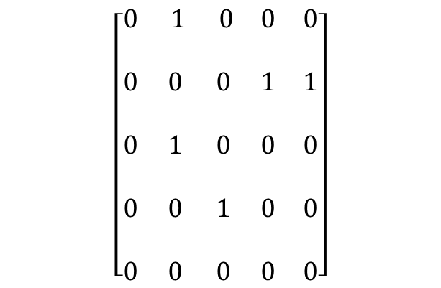
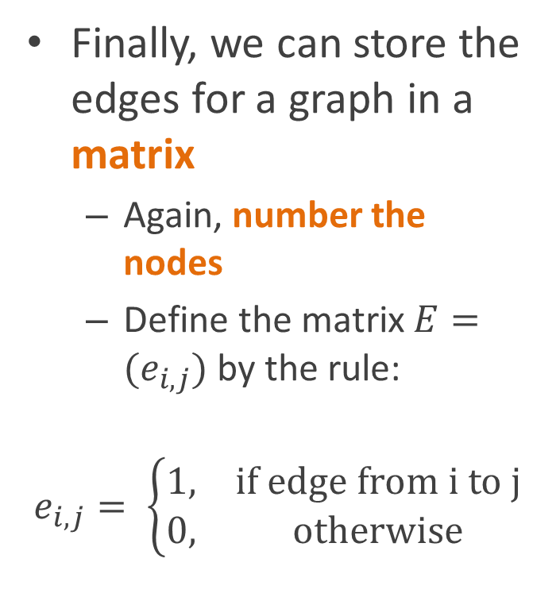
Adjacency matrix representation
Finally, we can store the edges for a graph in a matrix
  Again, number the nodes
  Define the matrix $E=(e_{i,j})$ by the rule:
$$e_{i,j}= \left\{\begin{matrix}1, & \text{if} \text{edge} \text{from} \text{i} \text{to} \text{j} \\ 0, & \text{otherwise}\end{matrix}\right.$$
2
1
3
5
4
$$\left[\begin{matrix}0 & 1 & 0 & 0 & 0 \\ & & & & \\ 0 & 0 & 0 & 1 & 1 \\ & & & & \\ 0 & 1 & 0 & 0 & 0 \\ & & & & \\ 0 & 0 & 1 & 0 & 0 \\ & & & & \\ 0 & 0 & 0 & 0 & 0\end{matrix}\right]$$

Slide 30
Adjacency matrix representation
Adjacency matrices are especially good for representing dense graphs
  Graphs in which most nodes have edges to most other nodes
2
1
3
5
4
$$\left[\begin{matrix}0 & 1 & 0 & 0 & 0 \\ & & & & \\ 0 & 0 & 0 & 1 & 1 \\ & & & & \\ 0 & 1 & 0 & 0 & 0 \\ & & & & \\ 0 & 0 & 1 & 0 & 0 \\ & & & & \\ 0 & 0 & 0 & 0 & 0\end{matrix}\right]$$

Slide 31
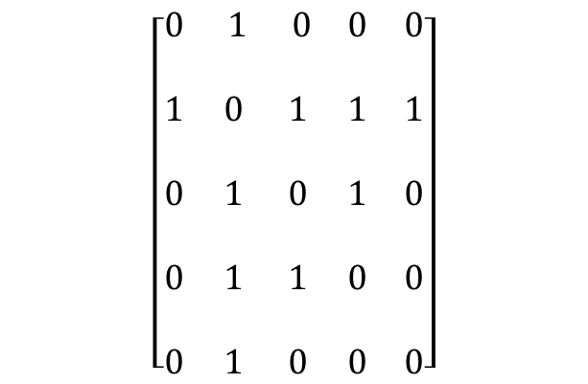
Undirected graphs
Recall that undirected graphs don’t distinguish between
  An edge from a to b, and
  An edge from b to a
2
1
3
5
4
$$\left[\begin{matrix}0 & 1 & 0 & 0 & 0 \\ & & & & \\ 1 & 0 & 1 & 1 & 1 \\ & & & & \\ 0 & 1 & 0 & 1 & 0 \\ & & & & \\ 0 & 1 & 1 & 0 & 0 \\ & & & & \\ 0 & 1 & 0 & 0 & 0\end{matrix}\right]$$

Slide 32
Undirected graphs
These are easily handled by both representations
  Adjacency lists: link a to b but also link b to a
  Adjacency matrix: matrix is just a symmetric matrix
2
1
3
5
4
$$\left[\begin{matrix}0 & 1 & 0 & 0 & 0 \\ & & & & \\ 1 & 0 & 1 & 1 & 1 \\ & & & & \\ 0 & 1 & 0 & 1 & 0 \\ & & & & \\ 0 & 1 & 1 & 0 & 0 \\ & & & & \\ 0 & 1 & 0 & 0 & 0\end{matrix}\right]$$
2
/
1
3
4
5
/
2
4
/
2
3
/
2
/

Slide 33
Weighted graphs
1
5
Edges are labeled with numerical values (weights)
  Usually represents some kind of distance or abstract “cost”
2
1
3
7
2
2
5
4
$$\left[\begin{matrix}0 & 1 & 0 & 0 & 0 \\ & & & & \\ 1 & 0 & 1 & 1 & 1 \\ & & & & \\ 0 & 1 & 0 & 1 & 0 \\ & & & & \\ 0 & 1 & 1 & 0 & 0 \\ & & & & \\ 0 & 1 & 0 & 0 & 0\end{matrix}\right]$$
2
/
1
3
4
5
/
2
4
/
2
3
/
2
/

Slide 34
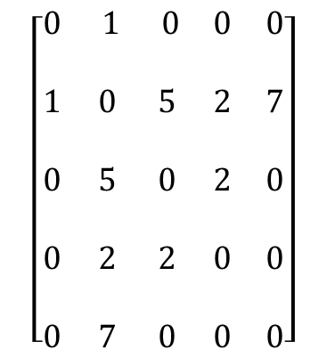
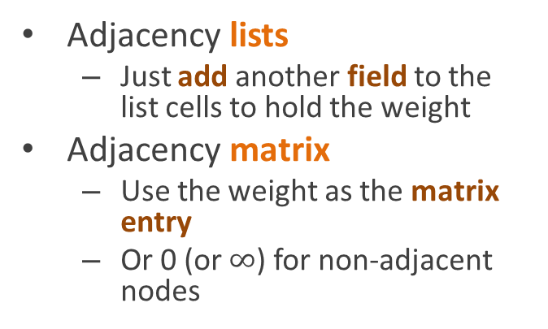
Representing weighted graphs
1
5
Adjacency lists
  Just add another field to the list cells to hold the weight
Adjacency matrix
  Use the weight as the matrix entry
  Or 0 (or $∞$) for non-adjacent nodes
2
1
3
7
2
2
5
4
$$\left[\begin{matrix}0 & 1 & 0 & 0 & 0 \\ & & & & \\ 1 & 0 & 5 & 2 & 7 \\ & & & & \\ 0 & 5 & 0 & 2 & 0 \\ & & & & \\ 0 & 2 & 2 & 0 & 0 \\ & & & & \\ 0 & 7 & 0 & 0 & 0\end{matrix}\right]$$
2
1
/
1
1
3
5
4
2
2
2
4
2
/
5
7
/
2
2
3
2
/
2
7
/

Slide 35
Breadth-first tree walk
1
Queue: 1
BreadthFirst(root) {
q = empty queue
q.Enqueue(root)
while q not empty {
node = q.Dequeue()
for each child c of node
q.Enqueue(c)
}
}
2
3
4
5
6
7

Slide 36
Breadth-first tree walk
1
Queue:
BreadthFirst(root) {
q = empty queue
q.Enqueue(root)
while q not empty {
node = q.Dequeue()
for each child c of node
q.Enqueue(c)
}
}
2
3
4
5
6
7

Slide 37
Breadth-first tree walk
1
Queue: 2
BreadthFirst(root) {
q = empty queue
q.Enqueue(root)
while q not empty {
node = q.Dequeue()
for each child c of node
q.Enqueue(c)
}
}
2
3
4
5
6
7

Slide 38
Breadth-first tree walk
1
Queue:
BreadthFirst(root) {
q = empty queue
q.Enqueue(root)
while q not empty {
node = q.Dequeue()
for each child c of node
q.Enqueue(c)
}
}
2
3
4
5
6
7

Slide 39
Breadth-first tree walk
1
Queue: 3 4
BreadthFirst(root) {
q = empty queue
q.Enqueue(root)
while q not empty {
node = q.Dequeue()
for each child c of node
q.Enqueue(c)
}
}
2
3
4
5
6
7

Slide 40
Breadth-first tree walk
1
Queue: 4
BreadthFirst(root) {
q = empty queue
q.Enqueue(root)
while q not empty {
node = q.Dequeue()
for each child c of node
q.Enqueue(c)
}
}
2
3
4
5
6
7

Slide 41
Breadth-first tree walk
1
Queue: 4
BreadthFirst(root) {
q = empty queue
q.Enqueue(root)
while q not empty {
node = q.Dequeue()
for each child c of node
q.Enqueue(c)
}
}
2
3
4
5
6
7

Slide 42
Breadth-first tree walk
1
Queue:
BreadthFirst(root) {
q = empty queue
q.Enqueue(root)
while q not empty {
node = q.Dequeue()
for each child c of node
q.Enqueue(c)
}
}
2
3
4
5
6
7

Slide 43
Breadth-first tree walk
1
Queue: 5
BreadthFirst(root) {
q = empty queue
q.Enqueue(root)
while q not empty {
node = q.Dequeue()
for each child c of node
q.Enqueue(c)
}
}
2
3
4
5
6
7

Slide 44
Breadth-first tree walk
1
Queue:
BreadthFirst(root) {
q = empty queue
q.Enqueue(root)
while q not empty {
node = q.Dequeue()
for each child c of node
q.Enqueue(c)
}
}
2
3
4
5
6
7

Slide 45
Breadth-first tree walk
1
Queue: 6 7
BreadthFirst(root) {
q = empty queue
q.Enqueue(root)
while q not empty {
node = q.Dequeue()
for each child c of node
q.Enqueue(c)
}
}
2
3
4
5
6
7

Slide 46
Breadth-first tree walk
1
Queue: 7
BreadthFirst(root) {
q = empty queue
q.Enqueue(root)
while q not empty {
node = q.Dequeue()
for each child c of node
q.Enqueue(c)
}
}
2
3
4
5
6
7

Slide 47
Breadth-first tree walk
1
Queue: 7
BreadthFirst(root) {
q = empty queue
q.Enqueue(root)
while q not empty {
node = q.Dequeue()
for each child c of node
q.Enqueue(c)
}
}
2
3
4
5
6
7

Slide 48
Breadth-first tree walk
1
Queue:
BreadthFirst(root) {
q = empty queue
q.Enqueue(root)
while q not empty {
node = q.Dequeue()
for each child c of node
q.Enqueue(c)
}
}
2
3
4
5
6
7

Slide 49
Breadth-first tree walk
1
Queue: 7
BreadthFirst(root) {
q = empty queue
q.Enqueue(root)
while q not empty {
node = q.Dequeue()
for each child c of node
q.Enqueue(c)
}
}
2
3
4
5
6
7

Slide 50
Breadth-first graph walk
1
Pseudocode:
BreadthFirst(root) {
q = empty queue
q.Enqueue(root)
while q not empty {
node = q.Dequeue()
for each child c of node
q.Enqueue(c)
}
}
2
3
4
5
Will this code work
for a general graph?
6
7

Slide 51
Breadth-first graph walk
1
Pseudocode:
BreadthFirst(start) {
q = empty queue
q.Enqueue(start)
while q not empty {
node = q.Dequeue()
for each neighbor c
q.Enqueue(c)
}
}
2
3
4
5
Well, first, there are
no children per se
6
7

Slide 52
Breadth-first graph walk
1
Pseudocode:
BreadthFirst(start) {
q = empty queue
q.Enqueue(start)
while q not empty {
node = q.Dequeue()
for each neighbor c
q.Enqueue(c)
}
}
2
3
4
5
What happens if
we just change it to
neighbor?
6
7

Slide 53
Breadth-first graph walk
1
Queue: 1
BreadthFirst(start) {
q = empty queue
q.Enqueue(start)
while q not empty {
node = q.Dequeue()
for each neighbor c
q.Enqueue(c)
}
}
2
3
4
5
6
7

Slide 54
Breadth-first graph walk
1
Queue:
BreadthFirst(start) {
q = empty queue
q.Enqueue(start)
while q not empty {
node = q.Dequeue()
for each neighbor c
q.Enqueue(c)
}
}
2
3
4
5
6
7

Slide 55
Breadth-first graph walk
1
Queue: 2 4
BreadthFirst(start) {
q = empty queue
q.Enqueue(start)
while q not empty {
node = q.Dequeue()
for each neighbor c
q.Enqueue(c)
}
}
2
3
4
5
6
7

Slide 56
Breadth-first graph walk
1
Queue: 4
BreadthFirst(start) {
q = empty queue
q.Enqueue(start)
while q not empty {
node = q.Dequeue()
for each neighbor c
q.Enqueue(c)
}
}
2
3
4
5
6
7

Slide 57
Breadth-first graph walk
1
Queue: 4 3 4 1
BreadthFirst(start) {
q = empty queue
q.Enqueue(start)
while q not empty {
node = q.Dequeue()
for each neighbor c
q.Enqueue(c)
}
}
2
3
4
5
6
7

Slide 58
uh oh …

Slide 59
Breadth-first graph walk
1
Queue: 3 4 1
BreadthFirst(start) {
q = empty queue
q.Enqueue(start)
while q not empty {
node = q.Dequeue()
for each neighbor c
q.Enqueue(c)
}
}
2
3
4
5
6
7

Slide 60
Breadth-first graph walk
1
Queue: 3 4 1 1 5
BreadthFirst(start) {
q = empty queue
q.Enqueue(start)
while q not empty {
node = q.Dequeue()
for each neighbor c
q.Enqueue(c)
}
}
2
3
4
5
6
7

Slide 61
this is not going to end well ...

Slide 62
actually, it’s not going to end at all …

Slide 63
Breadth-first graph walk
1
Pseudocode:
BreadthFirst(start) {
q = empty queue
q.Enqueue(start)
while q not empty {
node = q.Dequeue()
for each neighbor c of node
q.Enqueue(c)
}
}
2
3
4
5
We need to keep
from revisiting nodes
6
7

Slide 64
Breadth-first graph walk
1
Pseudocode:
BreadthFirst(start) {
q = empty queue
q.Enqueue(start)
mark start visited
while q not empty {
node = q.Dequeue()
for each neighbor c of node
if c not visited already
q.Enqueue(c)
mark c visited
}
}
2
3
4
5
6
7

Slide 65
Breadth-first graph walk
1
Queue:
BreadthFirst(start) {
q = empty queue
q.Enqueue(start)
mark start visited
while q not empty {
node = q.Dequeue()
for each neighbor c of node
if c not visited already
q.Enqueue(c)
mark c visited
}
}
2
3
4
5
6
7

Slide 66
Breadth-first graph walk
1
Queue: 1
BreadthFirst(start) {
q = empty queue
q.Enqueue(start)
mark start visited
while q not empty {
node = q.Dequeue()
for each neighbor c of node
if c not visited already
q.Enqueue(c)
mark c visited
}
}
2
3
4
5
6
7

Slide 67
Breadth-first graph walk
1
Queue:
BreadthFirst(start) {
q = empty queue
q.Enqueue(start)
mark start visited
while q not empty {
node = q.Dequeue()
for each neighbor c of node
if c not visited already
q.Enqueue(c)
mark c visited
}
}
2
3
4
5
6
7

Slide 68
Breadth-first graph walk
1
Queue: 2 4
BreadthFirst(start) {
q = empty queue
q.Enqueue(start)
mark start visited
while q not empty {
node = q.Dequeue()
for each neighbor c of node
if c not visited already
q.Enqueue(c)
mark c visited
}
}
2
3
4
5
6
7

Slide 69
Breadth-first graph walk
1
Queue: 4
BreadthFirst(start) {
q = empty queue
q.Enqueue(start)
mark start visited
while q not empty {
node = q.Dequeue()
for each neighbor c of node
if c not visited already
q.Enqueue(c)
mark c visited
}
}
2
3
4
5
6
7

Slide 70
Breadth-first graph walk
1
Queue: 4 3
BreadthFirst(start) {
q = empty queue
q.Enqueue(start)
mark start visited
while q not empty {
node = q.Dequeue()
for each neighbor c of node
if c not visited already
q.Enqueue(c)
mark c visited
}
}
2
3
4
5
6
7

Slide 71
Breadth-first graph walk
1
Queue: 3
BreadthFirst(start) {
q = empty queue
q.Enqueue(start)
mark start visited
while q not empty {
node = q.Dequeue()
for each neighbor c of node
if c not visited already
q.Enqueue(c)
mark c visited
}
}
2
3
4
5
6
7

Slide 72
Breadth-first graph walk
1
Queue: 3 5
BreadthFirst(start) {
q = empty queue
q.Enqueue(start)
mark start visited
while q not empty {
node = q.Dequeue()
for each neighbor c of node
if c not visited already
q.Enqueue(c)
mark c visited
}
}
2
3
4
5
6
7

Slide 73
Breadth-first graph walk
1
Queue: 5
BreadthFirst(start) {
q = empty queue
q.Enqueue(start)
mark start visited
while q not empty {
node = q.Dequeue()
for each neighbor c of node
if c not visited already
q.Enqueue(c)
mark c visited
}
}
2
3
4
5
6
7

Slide 74
Breadth-first graph walk
1
Queue: 5
BreadthFirst(start) {
q = empty queue
q.Enqueue(start)
mark start visited
while q not empty {
node = q.Dequeue()
for each neighbor c of node
if c not visited already
q.Enqueue(c)
mark c visited
}
}
2
3
4
5
6
7

Slide 75
Breadth-first graph walk
1
Queue:
BreadthFirst(start) {
q = empty queue
q.Enqueue(start)
mark start visited
while q not empty {
node = q.Dequeue()
for each neighbor c of node
if c not visited already
q.Enqueue(c)
mark c visited
}
}
2
3
4
5
6
7

Slide 76
Breadth-first graph walk
1
Queue: 6 7
BreadthFirst(start) {
q = empty queue
q.Enqueue(start)
mark start visited
while q not empty {
node = q.Dequeue()
for each neighbor c of node
if c not visited already
q.Enqueue(c)
mark c visited
}
}
2
3
4
5
6
7

Slide 77
Breadth-first graph walk
1
Queue: 7
BreadthFirst(start) {
q = empty queue
q.Enqueue(start)
mark start visited
while q not empty {
node = q.Dequeue()
for each neighbor c of node
if c not visited already
q.Enqueue(c)
mark c visited
}
}
2
3
4
5
6
7

Slide 78
Breadth-first graph walk
1
Queue: 7
BreadthFirst(start) {
q = empty queue
q.Enqueue(start)
mark start visited
while q not empty {
node = q.Dequeue()
for each neighbor c of node
if c not visited already
q.Enqueue(c)
mark c visited
}
}
2
3
4
5
6
7

Slide 79
Breadth-first graph walk
1
Tracking which nodes have been visited is sufficient to fix the problem
Great! How do we keep track of which nodes have been visited
2
3
4
5
6
7

Slide 80
Visit information in the nodes
One solution is to add a field to the node structure
Advantages
  Fast and efficient
Disadvantages
  You need to know in advance that you’ll be walking the graph
  Doesn’t work well if you’re using someone else’s graph implementation
  Uses memory even when you aren’t walking the graph
  Doesn’t work if you walk the graph twice
class GraphNode {
GraphNode[ ] adjacent;
bool visited = false;
}
node.visited = true;

Slide 81
Parallel array structure
Use a separate array
  Indexed by node number
Advantages
  Fast
  Can deallocate the array when it’s not being used
Disadvantages
  Requires nodes to be numbered
    But you often do that for other reasons anyway.
bool[ ] visited;
visited[node.number] = true;

Slide 82
Hash table
(or other dictionary structure)
If nothing else, you can use a hash table
  Use nodes as keys
Hashsets make more sense
  Hashtables but not dictionaries
  No value associated with the key
Advantages
  Easy
  Works with any graph representation
Disadvantages
  Slower than other approaches
Hashtable visited
= new Hashtable();
visited.Store(node, true);
HashSet visited
= new HashSet();
visited.Add(node);

Slide 83
Breadth-first search (from CLR)
1
Breadth-first walks are often called breadth-first searches
The CLR book defines a fancier version of BFS
It tracks additional information
  Distances of nodes from the start node
  Predecessors of nodes in the walk
    Which of its neighbors was searched first
2
3
4
5
6
7

Slide 84
Breadth-first search (from CLR)
1
BreadthFirstSearch(start) {
q = empty queue
q.Enqueue(start)
start.distance = 0
start.predecessor = null
mark start visited
while q not empty {
node = q.Dequeue()
for each neighbor c
if c not visited {
q.Enqueue(c)
c.distance = node.distance+1
c.predecessor = node
}
}
}
2
3
4
5
6
7

Slide 85
Breadth-first search (from CLR)
0
1
Queue: 1
BreadthFirstSearch(start) {
q = empty queue
q.Enqueue(start)
start.distance = 0
start.predecessor = null
mark start visited
while q not empty {
node = q.Dequeue()
for each neighbor c
if c not visited {
q.Enqueue(c)
c.distance = node.distance+1
c.predecessor = node
}
}
}
2
3
4
5
6
7

Slide 86
Breadth-first search (from CLR)
0
1
Queue:
BreadthFirstSearch(start) {
q = empty queue
q.Enqueue(start)
start.distance = 0
start.predecessor = null
mark start visited
while q not empty {
node = q.Dequeue()
for each neighbor c
if c not visited {
q.Enqueue(c)
c.distance = node.distance+1
c.predecessor = node
}
}
}
2
3
4
5
6
7

Slide 87
Breadth-first search (from CLR)
0
1
Queue: 2 4
BreadthFirstSearch(start) {
q = empty queue
q.Enqueue(start)
start.distance = 0
start.predecessor = null
mark start visited
while q not empty {
node = q.Dequeue()
for each neighbor c
if c not visited {
q.Enqueue(c)
c.distance = node.distance+1
c.predecessor = node
}
}
}
1
2
3
1
4
5
6
7

Slide 88
Breadth-first search (from CLR)
0
1
Queue: 4
BreadthFirstSearch(start) {
q = empty queue
q.Enqueue(start)
start.distance = 0
start.predecessor = null
mark start visited
while q not empty {
node = q.Dequeue()
for each neighbor c
if c not visited {
q.Enqueue(c)
c.distance = node.distance+1
c.predecessor = node
}
}
}
1
2
3
1
4
5
6
7

Slide 89
Breadth-first search (from CLR)
0
1
Queue: 4
BreadthFirstSearch(start) {
q = empty queue
q.Enqueue(start)
start.distance = 0
start.predecessor = null
mark start visited
while q not empty {
node = q.Dequeue()
for each neighbor c
if c not visited {
q.Enqueue(c)
c.distance = node.distance+1
c.predecessor = node
}
}
}
1
2
3
1
4
5
6
7

Slide 90
Breadth-first search (from CLR)
0
1
Queue: 4 3
BreadthFirstSearch(start) {
q = empty queue
q.Enqueue(start)
start.distance = 0
start.predecessor = null
mark start visited
while q not empty {
node = q.Dequeue()
for each neighbor c
if c not visited {
q.Enqueue(c)
c.distance = node.distance+1
c.predecessor = node
}
}
}
1
2
2
3
1
4
5
6
7

Slide 91
Breadth-first search (from CLR)
0
1
Queue: 3
BreadthFirstSearch(start) {
q = empty queue
q.Enqueue(start)
start.distance = 0
start.predecessor = null
mark start visited
while q not empty {
node = q.Dequeue()
for each neighbor c
if c not visited {
q.Enqueue(c)
c.distance = node.distance+1
c.predecessor = node
}
}
}
1
2
2
3
1
4
5
6
7

Slide 92
Breadth-first search (from CLR)
0
1
Queue: 3 5
BreadthFirstSearch(start) {
q = empty queue
q.Enqueue(start)
start.distance = 0
start.predecessor = null
mark start visited
while q not empty {
node = q.Dequeue()
for each neighbor c
if c not visited {
q.Enqueue(c)
c.distance = node.distance+1
c.predecessor = node
}
}
}
1
2
2
3
1
4
2
5
6
7

Slide 93
Breadth-first search (from CLR)
0
1
Queue: 5
BreadthFirstSearch(start) {
q = empty queue
q.Enqueue(start)
start.distance = 0
start.predecessor = null
mark start visited
while q not empty {
node = q.Dequeue()
for each neighbor c
if c not visited {
q.Enqueue(c)
c.distance = node.distance+1
c.predecessor = node
}
}
}
1
2
2
3
1
4
2
5
6
7

Slide 94
Breadth-first search (from CLR)
0
1
Queue:
BreadthFirstSearch(start) {
q = empty queue
q.Enqueue(start)
start.distance = 0
start.predecessor = null
mark start visited
while q not empty {
node = q.Dequeue()
for each neighbor c
if c not visited {
q.Enqueue(c)
c.distance = node.distance+1
c.predecessor = node
}
}
}
1
2
2
3
1
4
2
5
6
7

Slide 95
Breadth-first search (from CLR)
0
1
Queue: 6 7
BreadthFirstSearch(start) {
q = empty queue
q.Enqueue(start)
start.distance = 0
start.predecessor = null
mark start visited
while q not empty {
node = q.Dequeue()
for each neighbor c
if c not visited {
q.Enqueue(c)
c.distance = node.distance+1
c.predecessor = node
}
}
}
1
2
2
3
1
4
2
5
3
3
6
7

Slide 96
Breadth-first search (from CLR)
0
1
Queue: 7
BreadthFirstSearch(start) {
q = empty queue
q.Enqueue(start)
start.distance = 0
start.predecessor = null
mark start visited
while q not empty {
node = q.Dequeue()
for each neighbor c
if c not visited {
q.Enqueue(c)
c.distance = node.distance+1
c.predecessor = node
}
}
}
1
2
2
3
1
4
2
5
3
3
6
7

Slide 97
Breadth-first search (from CLR)
0
1
Queue:
BreadthFirstSearch(start) {
q = empty queue
q.Enqueue(start)
start.distance = 0
start.predecessor = null
mark start visited
while q not empty {
node = q.Dequeue()
for each neighbor c
if c not visited {
q.Enqueue(c)
c.distance = node.distance+1
c.predecessor = node
}
}
}
1
2
2
3
1
4
2
5
3
3
6
7

Slide 98
Breadth-first search (from CLR)
0
1
Queue:
BreadthFirstSearch(start) {
q = empty queue
q.Enqueue(start)
start.distance = 0
start.predecessor = null
mark start visited
while q not empty {
node = q.Dequeue()
for each neighbor c
if c not visited {
q.Enqueue(c)
c.distance = node.distance+1
c.predecessor = node
}
}
}
1
2
2
3
1
4
2
5
3
3
6
7

Slide 99
Breadth-first search (from CLR)
0
1
Notice
Every node is labeled with its distance from the start node
1
2
2
3
1
4
2
5
3
3
6
7

Slide 100
Breadth-first search (from CLR)
0
1
Notice
Every node is labeled with its distance from the start node
The predecessor subgraph (formed using only the edges corresponding to predecessor links) forms a tree
  Called a breadth-first tree
The predecessor links give you the shortest path from any node back to the start node
  Technically, it’s a shortest path
  Since there might be other paths in the original graph of the same length
1
2
2
3
1
4
2
5
3
3
6
7

Slide 101
Foster to Quincy:
Route planning for the El
(If we pretend the El can drive in any direction)
Foster
Merchandise Mart
Clark/Lake
State/Lake
Randolf/Wabash
Washington/Wells
Madison/Wabash
Quincy
Adams/Wabash
LaSalle
Library

Slide 102
Foster to Quincy:
Route planning for the El
Foster
0
Queue: Foster
Merchandise Mart
Clark/Lake
State/Lake
Randolf/Wabash
Washington/Wells
Madison/Wabash
Quincy
Adams/Wabash
LaSalle
Library

Slide 103
Foster to Quincy:
Route planning for the El
Foster
0
Queue: Randolf
Merchandise Mart
Clark/Lake
State/Lake
Randolf/Wabash
Washington/Wells
1
Madison/Wabash
Quincy
Adams/Wabash
LaSalle
Library

Slide 104
Foster to Quincy:
Route planning for the El
Foster
0
Queue: Madison, State
Merchandise Mart
Clark/Lake
State/Lake
2
Randolf/Wabash
Washington/Wells
1
Madison/Wabash
2
Quincy
Adams/Wabash
LaSalle
Library

Slide 105
Foster to Quincy:
Route planning for the El
Foster
0
Queue: State, Adams
Merchandise Mart
Clark/Lake
State/Lake
2
Randolf/Wabash
Washington/Wells
1
Madison/Wabash
2
Quincy
Adams/Wabash
LaSalle
Library
3

Slide 106
Foster to Quincy:
Route planning for the El
Foster
0
Queue: Adams, Clark
Merchandise Mart
Clark/Lake
State/Lake
3
2
Randolf/Wabash
Washington/Wells
1
Madison/Wabash
2
Quincy
Adams/Wabash
LaSalle
Library
3

Slide 107
Foster to Quincy:
Route planning for the El
Foster
0
Queue: Clark, Library
Merchandise Mart
Clark/Lake
State/Lake
3
2
Randolf/Wabash
Washington/Wells
1
Madison/Wabash
2
Quincy
Adams/Wabash
LaSalle
Library
3
4

Slide 108
Foster to Quincy:
Route planning for the El
Foster
0
Queue: Library, Mmart, Washington
Merchandise Mart
Clark/Lake
State/Lake
4
3
2
Randolf/Wabash
Washington/Wells
1
4
Madison/Wabash
2
Quincy
Adams/Wabash
LaSalle
Library
3
4
4

Slide 109
Foster to Quincy:
Route planning for the El
Foster
0
Queue: Mmart, Washington, LaSalle
Merchandise Mart
Clark/Lake
State/Lake
4
3
2
Randolf/Wabash
Washington/Wells
1
4
Madison/Wabash
2
Quincy
Adams/Wabash
LaSalle
Library
3
5
4

Slide 110
Foster to Quincy:
Route planning for the El
Foster
0
Queue: Washington, LaSalle
Merchandise Mart
Clark/Lake
State/Lake
4
3
2
Randolf/Wabash
Washington/Wells
1
4
Madison/Wabash
2
Quincy
Adams/Wabash
LaSalle
Library
3
5
4

Slide 111
Foster to Quincy:
Route planning for the El
Foster
0
Queue: LaSalle
Merchandise Mart
Clark/Lake
State/Lake
4
3
2
Randolf/Wabash
Washington/Wells
1
4
Madison/Wabash
2
Quincy
5
Adams/Wabash
LaSalle
Library
3
5
4

Slide 112
Foster to Quincy:
Route planning for the El
Foster
0
We’ve found the destination
Merchandise Mart
Clark/Lake
State/Lake
4
3
2
Randolf/Wabash
Washington/Wells
1
4
Madison/Wabash
2
Quincy
5
Adams/Wabash
LaSalle
Library
3
5
4

Slide 113
Foster to Quincy:
Route planning for the El
Foster
0
To find the shortest path,
Merchandise Mart
Clark/Lake
State/Lake
4
3
2
Randolf/Wabash
Washington/Wells
1
4
Madison/Wabash
2
Quincy
5
Adams/Wabash
LaSalle
Library
3
5
4

Slide 114
Foster to Quincy:
Route planning for the El
Foster
0
Just trace the predecessor links
Merchandise Mart
Clark/Lake
State/Lake
4
3
2
Randolf/Wabash
Washington/Wells
1
4
Madison/Wabash
2
Quincy
5
Adams/Wabash
LaSalle
Library
3
5
4

Slide 115
Complexity analysis
How many times does each line run?
1
BreadthFirstSearch(start) {
q = empty queue
q.Enqueue(start)
start.distance = 0
start.predecessor = null
mark start visited
while q not empty {
node = q.Dequeue()
for each neighbor c
if c not visited {
q.Enqueue(c)
c.distance = node.distance+1
c.predecessor = node
}
}
}
2
3
4
5
6
7

Slide 116
Complexity analysis
Each individual line takes constant time
1
BreadthFirstSearch(start) {
q = empty queue
q.Enqueue(start)
start.distance = 0
start.predecessor = null
mark start visited
while q not empty {
node = q.Dequeue()
for each neighbor c
if c not visited {
q.Enqueue(c)
c.distance = node.distance+1
c.predecessor = node
}
}
}
2
3
4
5
6
7

Slide 117
Complexity analysis
How many times does each line run?
BreadthFirstSearch(start) {
q = empty queue
q.Enqueue(start)
start.distance = 0
start.predecessor = null
mark start visited
while q not empty {
node = q.Dequeue()
for each neighbor c
if c not visited {
q.Enqueue(c)
c.distance = node.distance+1
c.predecessor = node
}
}
}

Slide 118
Complexity analysis
How many times does each line run?
BreadthFirstSearch(start) {
q = empty queue
q.Enqueue(start)
start.distance = 0
start.predecessor = null
mark start visited
while q not empty {
node = q.Dequeue()
for each neighbor c
if c not visited {
q.Enqueue(c)
c.distance = node.distance+1
c.predecessor = node
}
}
}
One time only
Once per vertex
Once per edge
Once per vertex

Slide 119
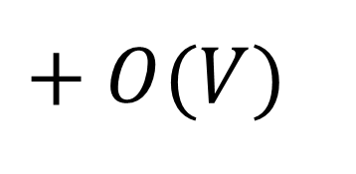
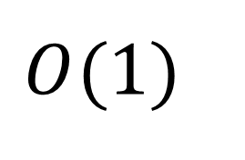
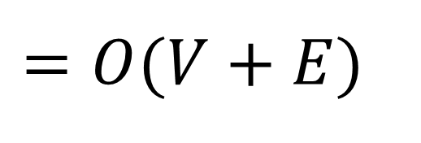
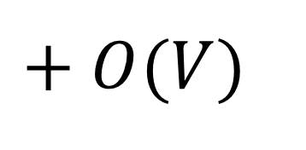
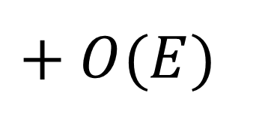
Complexity analysis
How many times does each line run?
BreadthFirstSearch(start) {
q = empty queue
q.Enqueue(start)
start.distance = 0
start.predecessor = null
mark start visited
while q not empty {
node = q.Dequeue()
for each neighbor c
if c not visited {
q.Enqueue(c)
c.distance = node.distance+1
c.predecessor = node
}
}
}
$$O(1)$$
$$+ O(V)$$
$$+ O(E)$$
$$+ O(V)$$
$$=O(V+E)$$

Slide 120
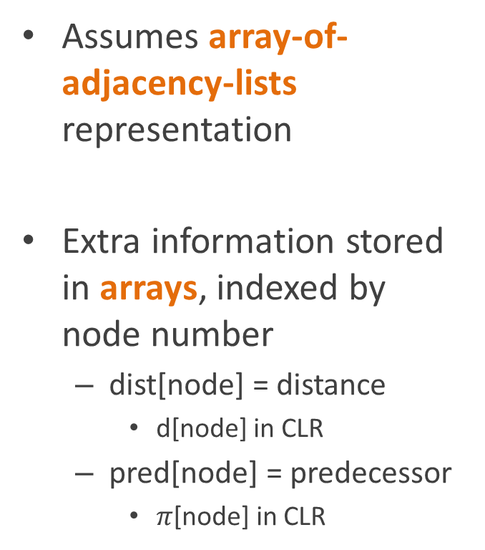
BFS algorithm in the books
Assumes array-of-adjacency-lists representation
Extra information stored in arrays, indexed by node number
  dist[node] = distance
    d[node] in CLR
  pred[node] = predecessor
    $π$[node] in CLR
“Colors” the nodes rather than marking them visted
  Three colors
    White = unvisited
    Gray = in the queue or being processed now
    Black = finshed processing
  Stored in color[node]

Slide 121
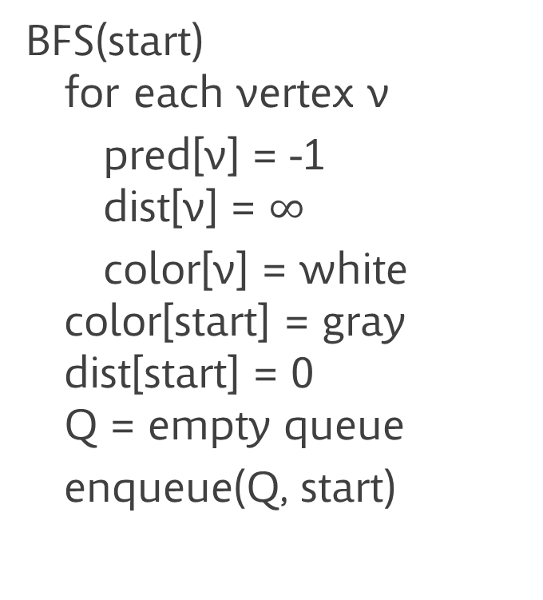
The actual code
BFS(start)
for each vertex v
pred[v] = -1
dist[v] = $∞$
color[v] = white
color[start] = gray
dist[start] = 0
Q = empty queue
enqueue(Q, start)
while Q not empty
u = head of Q
for each neighbor v of u
if color[v] = white
dist[v] = dist[u]+1
pred[v] = u
color[v] = gray
Q.Enqueue(v)
Q.Dequeue()
color[u] = black

Slide 122
Depth-first search of a tree
1
DepthFirst(node)
for each child c of node
DepthFirst(c)
Again, this doesn’t quite work
  No children per se
  Need to keep from re-visiting nodes
2
3
4
5
6
7

Slide 123
Depth-first search of a graph
1
DepthFirst(node)
mark node visited
for each unvisited
neighbor, c, of node
DepthFirst(c)
We fix it by keeping track of what nodes have already been visited
2
3
4
5
6
7

Slide 124
Depth-first search of a graph
1
DepthFirst(node)
mark node visited
for each unvisited
neighbor, c, of node
DepthFirst(c)
However, in practice, one of the things DFS is most often used for is analyzing the connectivity of a graph
2
3
4
5
6
7

Slide 125
Depth-first search of a graph
1
DepthFirst(node)
mark node visited
for each unvisited
neighbor, c, of node
DepthFirst(c)
So it’s often run on an unconnected graph
Which means that not every node will be visited
4
2
3
8
9
11
5
12
6
7

Slide 126
Depth-first search of a graph
1
DepthFirst()
for each node in graph
if node not visited
DFSVisit(node)
DFSVisit(node)
mark node visited
foreach unvisited
neighbor, c, of node
DFSVisit(c)
So we modify it to run it on every node
4
2
3
8
9
11
5
12
6
7

Slide 127
Depth-first search of a graph
1
DepthFirst()
for each node in graph
if node not visited
DFSVisit(node)
DFSVisit(node)
mark node visited
for each unvisited neighbor c
DFSVisit(c)
Call Stack:
DepthFirst()
4
2
3
8
9
11
5
12
6
7

Slide 128
Depth-first search of a graph
1
DepthFirst()
for each node in graph
if node not visited
DFSVisit(node)
DFSVisit(node)
mark node visited
for each unvisited neighbor c
DFSVisit(c)
Call Stack:
DepthFirst()
DFSVisit(1)
4
2
3
8
9
11
5
12
6
7

Slide 129
Depth-first search of a graph
1
DepthFirst()
for each node in graph
if node not visited
DFSVisit(node)
DFSVisit(node)
mark node visited
for each unvisited neighbor, c
DFSVisit(c)
Call Stack:
DepthFirst()
DFSVisit(1)
DFSVisit(2)
4
2
3
8
9
11
5
12
6
7

Slide 130
Depth-first search of a graph
1
DepthFirst()
for each node in graph
if node not visited
DFSVisit(node)
DFSVisit(node)
mark node visited
for each unvisited neighbor, c, of node
DFSVisit(c)
Call Stack:
DepthFirst()
DFSVisit(1)
DFSVisit(2)
DFSVisit(3)
4
2
3
8
9
11
5
12
6
7

Slide 131
Depth-first search of a graph
1
DepthFirst()
for each node in graph
if node not visited
DFSVisit(node)
DFSVisit(node)
mark node visited
for each unvisited neighbor, c, of node
DFSVisit(c)
Call Stack:
DepthFirst()
DFSVisit(1)
DFSVisit(2)
DFSVisit(3)
DFSVisit(9)
4
2
3
8
9
11
5
12
6
7

Slide 132
Depth-first search of a graph
1
DepthFirst()
for each node in graph
if node not visited
DFSVisit(node)
DFSVisit(node)
mark node visited
for each unvisited neighbor, c, of node
DFSVisit(c)
Call Stack:
DepthFirst()
DFSVisit(1)
DFSVisit(2)
DFSVisit(3)
DFSVisit(9)
DFSVisit(8)
4
2
3
8
9
11
5
12
6
7

Slide 133
Depth-first search of a graph
1
DepthFirst()
for each node in graph
if node not visited
DFSVisit(node)
DFSVisit(node)
mark node visited
for each unvisited neighbor, c, of node
DFSVisit(c)
Call Stack:
DepthFirst()
DFSVisit(1)
DFSVisit(2)
DFSVisit(3)
DFSVisit(9)
4
2
3
8
9
11
5
12
6
7

Slide 134
Depth-first search of a graph
1
DepthFirst()
for each node in graph
if node not visited
DFSVisit(node)
DFSVisit(node)
mark node visited
for each unvisited neighbor, c, of node
DFSVisit(c)
Call Stack:
DepthFirst()
DFSVisit(1)
DFSVisit(2)
DFSVisit(3)
4
2
3
8
9
11
5
12
6
7

Slide 135
Depth-first search of a graph
1
DepthFirst()
for each node in graph
if node not visited
DFSVisit(node)
DFSVisit(node)
mark node visited
for each unvisited neighbor, c, of node
DFSVisit(c)
Call Stack:
DepthFirst()
DFSVisit(1)
DFSVisit(2)
4
2
3
8
9
11
5
12
6
7

Slide 136
Depth-first search of a graph
1
DepthFirst()
for each node in graph
if node not visited
DFSVisit(node)
DFSVisit(node)
mark node visited
for each unvisited neighbor, c, of node
DFSVisit(c)
Call Stack:
DepthFirst()
DFSVisit(1)
DFSVisit(2)
DFSVisit(4)
4
2
3
8
9
11
5
12
6
7

Slide 137
Depth-first search of a graph
1
DepthFirst()
for each node in graph
if node not visited
DFSVisit(node)
DFSVisit(node)
mark node visited
for each unvisited neighbor, c, of node
DFSVisit(c)
Call Stack:
DepthFirst()
DFSVisit(1)
DFSVisit(2)
4
2
3
8
9
11
5
12
6
7

Slide 138
Depth-first search of a graph
1
DepthFirst()
for each node in graph
if node not visited
DFSVisit(node)
DFSVisit(node)
mark node visited
for each unvisited neighbor, c, of node
DFSVisit(c)
Call Stack:
DepthFirst()
DFSVisit(1)
4
2
3
8
9
11
5
12
6
7

Slide 139
Depth-first search of a graph
1
DepthFirst()
for each node in graph
if node not visited
DFSVisit(node)
DFSVisit(node)
mark node visited
for each unvisited neighbor, c, of node
DFSVisit(c)
Call Stack:
DepthFirst()
DFSVisit(1)
DFSVisit(4)
4
2
3
8
9
11
5
12
6
7

Slide 140
Depth-first search of a graph
1
DepthFirst()
for each node in graph
if node not visited
DFSVisit(node)
DFSVisit(node)
mark node visited
for each unvisited neighbor, c, of node
DFSVisit(c)
Call Stack:
DepthFirst()
DFSVisit(1)
4
2
3
8
9
11
5
12
6
7

Slide 141
Depth-first search of a graph
1
DepthFirst()
for each node in graph
if node not visited
DFSVisit(node)
DFSVisit(node)
mark node visited
for each unvisited neighbor, c, of node
DFSVisit(c)
Call Stack:
DepthFirst()
4
2
3
8
9
11
5
12
6
7

Slide 142
Depth-first search of a graph
1
DepthFirst()
for each node in graph
if node not visited
DFSVisit(node)
DFSVisit(node)
mark node visited
for each unvisited neighbor, c, of node
DFSVisit(c)
Call Stack:
DepthFirst()
DFSVisit(5)
4
2
3
8
9
11
5
12
6
7

Slide 143
Depth-first search of a graph
1
DepthFirst()
for each node in graph
if node not visited
DFSVisit(node)
DFSVisit(node)
mark node visited
for each unvisited neighbor, c, of node
DFSVisit(c)
Call Stack:
DepthFirst()
DFSVisit(5)
DFSVisit(6)
4
2
3
8
9
11
5
12
6
7

Slide 144
Depth-first search of a graph
1
DepthFirst()
for each node in graph
if node not visited
DFSVisit(node)
DFSVisit(node)
mark node visited
for each unvisited neighbor, c, of node
DFSVisit(c)
Call Stack:
DepthFirst()
DFSVisit(5)
DFSVisit(6)
DFSVisit(11)
4
2
3
8
9
11
5
12
6
7

Slide 145
Depth-first search of a graph
1
DepthFirst()
for each node in graph
if node not visited
DFSVisit(node)
DFSVisit(node)
mark node visited
for each unvisited neighbor, c, of node
DFSVisit(c)
Call Stack:
DepthFirst()
DFSVisit(5)
DFSVisit(6)
4
2
3
8
9
11
5
12
6
7

Slide 146
Depth-first search of a graph
1
DepthFirst()
for each node in graph
if node not visited
DFSVisit(node)
DFSVisit(node)
mark node visited
for each unvisited neighbor, c, of node
DFSVisit(c)
Call Stack:
DepthFirst()
DFSVisit(5)
4
2
3
8
9
11
5
12
6
7

Slide 147
Depth-first search of a graph
1
DepthFirst()
for each node in graph
if node not visited
DFSVisit(node)
DFSVisit(node)
mark node visited
for each unvisited neighbor, c, of node
DFSVisit(c)
Call Stack:
DepthFirst()
DFSVisit(5)
DFSVisit(7)
4
2
3
8
9
11
5
12
6
7

Slide 148
Depth-first search of a graph
1
DepthFirst()
for each node in graph
if node not visited
DFSVisit(node)
DFSVisit(node)
mark node visited
for each unvisited neighbor, c, of node
DFSVisit(c)
Call Stack:
DepthFirst()
DFSVisit(5)
4
2
3
8
9
11
5
12
6
7

Slide 149
Depth-first search of a graph
1
DepthFirst()
for each node in graph
if node not visited
DFSVisit(node)
DFSVisit(node)
mark node visited
for each unvisited neighbor, c, of node
DFSVisit(c)
Call Stack:
DepthFirst()
4
2
3
8
9
11
5
12
6
7

Slide 150
Depth-first search of a graph
1
DepthFirst()
for each node in graph
if node not visited
DFSVisit(node)
DFSVisit(node)
mark node visited
for each unvisited neighbor, c, of node
DFSVisit(c)
Call Stack:
DepthFirst()
DFSVisit(12)
4
2
3
8
9
11
5
12
6
7

Slide 151
Depth-first search of a graph
1
DepthFirst()
for each node in graph
if node not visited
DFSVisit(node)
DFSVisit(node)
mark node visited
for each unvisited neighbor, c, of node
DFSVisit(c)
Call Stack:
DepthFirst()
4
2
3
8
9
11
5
12
6
7

Slide 152
Depth-first search of a graph
1
DepthFirst()
for each node in graph
if node not visited
DFSVisit(node)
DFSVisit(node)
mark node visited
for each unvisited neighbor, c, of node
DFSVisit(c)
Call Stack:
Done!
4
2
3
8
9
11
5
12
6
7

Slide 153
Analysis: how many times are these lines run?
DepthFirst()
for each node in graph
if node not visited
DFSVisit(node)
DFSVisit(node)
mark node visited
for each neighbor, c, of node
if c not visited
DFSVisit(c)

Slide 154
Analysis
DepthFirst()
for each node in graph
if node not visited
DFSVisit(node)
DFSVisit(node)
mark node visited
for each neighbor, c, of node
if c not visited
DFSVisit(c)
Once per vertex
Once per vertex
Once per edge
Once per vertex

Slide 155
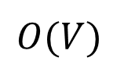
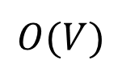
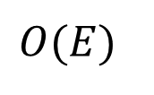
Analysis
DepthFirst()
for each node in graph
if node not visited
DFSVisit(node)
DFSVisit(node)
mark node visited
for each neighbor, c, of node
if c not visited
DFSVisit(c)
$$O(V)$$
$$O(V)$$
$$O(E)$$
$$O(V)$$

Slide 156

Analysis: $O(V+E)$ time
DepthFirst()
for each node in graph
if node not visited
DFSVisit(node)
DFSVisit(node)
mark node visited
for each neighbor, c, of node
if c not visited
DFSVisit(c)
$$O(V)$$
$$O(V)$$
$$O(E)$$
$$O(V)$$

Slide 157
Example application: connected component analysis
LabelConnectedComponents()
component = 0
for each node in graph
if node not visited
LCCVisit(node, component)
component++
LCCVisit(node, c)
mark node visited
node.component = c
for each unvisited
neighbor, n, of node
LCCVisit(n, c)
1
4
2
3
8
9
11
5
12
6
7

Slide 158
Example application: connected component analysis
LabelConnectedComponents()
component = 0
for each node in graph
if node not visited
LCCVisit(node, component)
component++
LCCVisit(node, c)
mark node visited
node.component = c
for each unvisited
neighbor, n, of node
LCCVisit(n, c)
1
4
2
3
8
9
11
5
12
6
7

Slide 159
Example application: connected component analysis
LabelConnectedComponents()
component = 0
for each node in graph
if node not visited
LCCVisit(node, component)
component++
LCCVisit(node, c)
mark node visited
node.component = c
for each unvisited
neighbor, n, of node
LCCVisit(n, c)
1
4
2
3
8
9
11
5
12
6
7

Slide 160
Example application: connected component analysis
0
LabelConnectedComponents()
component = 0
for each node in graph
if node not visited
LCCVisit(node, component)
component++
LCCVisit(node, c)
mark node visited
node.component = c
for each unvisited
neighbor, n, of node
LCCVisit(n, c)
1
4
2
3
8
9
11
5
12
6
7

Slide 161
Example application: connected component analysis
0
LabelConnectedComponents()
component = 0
for each node in graph
if node not visited
LCCVisit(node, component)
component++
LCCVisit(node, c)
mark node visited
node.component = c
for each unvisited
neighbor, n, of node
LCCVisit(n, c)
1
4
2
3
8
9
11
5
12
6
7

Slide 162
Example application: connected component analysis
0
LabelConnectedComponents()
component = 0
for each node in graph
if node not visited
LCCVisit(node, component)
component++
LCCVisit(node, c)
mark node visited
node.component = c
for each unvisited
neighbor, n, of node
LCCVisit(n, c)
1
4
0
2
3
8
9
11
5
12
6
7

Slide 163
Example application: connected component analysis
0
LabelConnectedComponents()
component = 0
for each node in graph
if node not visited
LCCVisit(node, component)
component++
LCCVisit(node, c)
mark node visited
node.component = c
for each unvisited
neighbor, n, of node
LCCVisit(n, c)
1
4
0
2
0
3
8
9
11
5
12
6
7

Slide 164
Example application: connected component analysis
0
LabelConnectedComponents()
component = 0
for each node in graph
if node not visited
LCCVisit(node, component)
component++
LCCVisit(node, c)
mark node visited
node.component = c
for each unvisited
neighbor, n, of node
LCCVisit(n, c)
1
4
0
2
0
3
8
0
9
11
5
12
6
7

Slide 165
Example application: connected component analysis
0
LabelConnectedComponents()
component = 0
for each node in graph
if node not visited
LCCVisit(node, component)
component++
LCCVisit(node, c)
mark node visited
node.component = c
for each unvisited
neighbor, n, of node
LCCVisit(n, c)
1
4
0
2
0
3
0
8
0
9
11
5
12
6
7

Slide 166
Example application: connected component analysis
0
LabelConnectedComponents()
component = 0
for each node in graph
if node not visited
LCCVisit(node, component)
component++
LCCVisit(node, c)
mark node visited
node.component = c
for each unvisited
neighbor, n, of node
LCCVisit(n, c)
1
0
4
0
2
0
3
0
8
0
9
11
5
12
6
7

Slide 167
Example application: connected component analysis
0
LabelConnectedComponents()
component = 0
for each node in graph
if node not visited
LCCVisit(node, component)
component++
LCCVisit(node, c)
mark node visited
node.component = c
for each unvisited
neighbor, n, of node
LCCVisit(n, c)
1
0
4
0
2
0
3
0
8
0
9
11
5
12
6
7

Slide 168
Example application: connected component analysis
0
LabelConnectedComponents()
component = 0
for each node in graph
if node not visited
LCCVisit(node, component)
component++
LCCVisit(node, c)
mark node visited
node.component = c
for each unvisited
neighbor, n, of node
LCCVisit(n, c)
1
0
4
0
2
0
3
0
8
0
9
11
5
12
6
7

Slide 169
Example application: connected component analysis
0
LabelConnectedComponents()
component = 0
for each node in graph
if node not visited
LCCVisit(node, component)
component++
LCCVisit(node, c)
mark node visited
node.component = c
for each unvisited
neighbor, n, of node
LCCVisit(n, c)
1
0
4
0
2
0
3
0
8
0
9
1
11
5
12
6
7

Slide 170
Example application: connected component analysis
0
LabelConnectedComponents()
component = 0
for each node in graph
if node not visited
LCCVisit(node, component)
component++
LCCVisit(node, c)
mark node visited
node.component = c
for each unvisited
neighbor, n, of node
LCCVisit(n, c)
1
0
4
0
2
0
3
0
8
0
9
1
11
5
12
1
6
7

Slide 171
Example application: connected component analysis
0
LabelConnectedComponents()
component = 0
for each node in graph
if node not visited
LCCVisit(node, component)
component++
LCCVisit(node, c)
mark node visited
node.component = c
for each unvisited
neighbor, n, of node
LCCVisit(n, c)
1
0
4
0
2
0
3
0
8
0
9
1
1
11
5
12
1
6
7

Slide 172
Example application: connected component analysis
0
LabelConnectedComponents()
component = 0
for each node in graph
if node not visited
LCCVisit(node, component)
component++
LCCVisit(node, c)
mark node visited
node.component = c
for each unvisited
neighbor, n, of node
LCCVisit(n, c)
1
0
4
0
2
0
3
0
8
0
9
1
1
11
5
12
1
1
6
7

Slide 173
Example application: connected component analysis
0
LabelConnectedComponents()
component = 0
for each node in graph
if node not visited
LCCVisit(node, component)
component++
LCCVisit(node, c)
mark node visited
node.component = c
for each unvisited
neighbor, n, of node
LCCVisit(n, c)
1
0
4
0
2
0
3
0
8
0
9
1
1
11
5
12
1
1
6
7

Slide 174
Example application: connected component analysis
0
LabelConnectedComponents()
component = 0
for each node in graph
if node not visited
LCCVisit(node, component)
component++
LCCVisit(node, c)
mark node visited
node.component = c
for each unvisited
neighbor, n, of node
LCCVisit(n, c)
1
0
4
0
2
0
3
0
8
0
9
1
1
11
5
12
1
1
6
7

Slide 175
Example application: connected component analysis
0
LabelConnectedComponents()
component = 0
for each node in graph
if node not visited
LCCVisit(node, component)
component++
LCCVisit(node, c)
mark node visited
node.component = c
for each unvisited
neighbor, n, of node
LCCVisit(n, c)
1
0
4
0
2
0
3
0
8
0
9
1
1
11
5
2
12
1
1
6
7

Slide 176
Example application: topological sort
Cook
Given a connected, directed acyclic graph (DAG)
Find an ordering of the nodes such that for any nodes a, b
  If there is an edge from a to b
  b comes after a in the ordering
  Alternate version: b comes before a in the order
Useful for problems such as scheduling tasks
  Make a graph of the dependencies between subtasks
  Topologically sort it
Mix ingredients
Chop
veggies
Whip
Crack
eggs
Get ingredients
from fridge

Slide 177
Example application: topological sort
Cook
Essentially a fancy post-order traversal
Used to find total orderings from partial orderings
If you’ve used the make program on linux, it’s essentially doing a topological sort to decide what order to compile things in
Mix ingredients
Chop
veggies
Whip
Crack
eggs
Get ingredients
from fridge

Slide 178
Example application: topological sort
Cook
TopologicalSort(start)
list = new empty list
TopologicalVisit(start)
TopologicalVisit(node)
for each node n with an
edge from node to n
if n not visited
TopologicalVisit(n)
mark node visited
add node to list
Mix ingredients
Chop
veggies
Whip
Crack
eggs
Get ingredients
from fridge

Slide 179
Example application: topological sort
Cook
TopologicalVist(cook)
Mix ingredients
Chop
veggies
Whip
Crack
eggs
Output list: <empty>
Get ingredients
from fridge

Slide 180
Example application: topological sort
Cook
TopologicalVist(cook)
TopologicalVist(mix)
Mix ingredients
Chop
veggies
Whip
Crack
eggs
Output list: <empty>
Get ingredients
from fridge

Slide 181
Example application: topological sort
Cook
TopologicalVist(cook)
TopologicalVist(mix)
TopologicalVist(chop)
Mix ingredients
Chop
veggies
Whip
Crack
eggs
Output list: <empty>
Get ingredients
from fridge

Slide 182
Example application: topological sort
Cook
TopologicalVist(cook)
TopologicalVist(mix)
TopologicalVist(chop)
TopologicalVist(get)
Mix ingredients
Chop
veggies
Whip
Crack
eggs
Output list: <empty>
Get ingredients
from fridge

Slide 183
Example application: topological sort
Cook
TopologicalVist(cook)
TopologicalVist(mix)
TopologicalVist(chop)
TopologicalVist(get)
Mix ingredients
Chop
veggies
Whip
Crack
eggs
Output list: get
Get ingredients
from fridge

Slide 184
Example application: topological sort
Cook
TopologicalVist(cook)
TopologicalVist(mix)
TopologicalVist(chop)
Mix ingredients
Chop
veggies
Whip
Crack
eggs
Output list: get, chop
Get ingredients
from fridge

Slide 185
Example application: topological sort
Cook
TopologicalVist(cook)
TopologicalVist(mix)
Mix ingredients
Chop
veggies
Whip
Crack
eggs
Output list: get, chop
Get ingredients
from fridge

Slide 186
Example application: topological sort
Cook
TopologicalVist(cook)
TopologicalVist(mix)
TopologicalVist(whip)
Mix ingredients
Chop
veggies
Whip
Crack
eggs
Output list: get, chop
Get ingredients
from fridge

Slide 187
Example application: topological sort
Cook
TopologicalVist(cook)
TopologicalVist(mix)
TopologicalVist(whip)
TopologicalVist(crack)
Mix ingredients
Chop
veggies
Whip
Crack
eggs
Output list: get, chop
Get ingredients
from fridge

Slide 188
Example application: topological sort
Cook
TopologicalVist(cook)
TopologicalVist(mix)
TopologicalVist(whip)
TopologicalVist(crack)
Mix ingredients
Chop
veggies
Whip
Crack
eggs
Output list: get, chop, crack
Get ingredients
from fridge

Slide 189
Example application: topological sort
Cook
TopologicalVist(cook)
TopologicalVist(mix)
TopologicalVist(whip)
Mix ingredients
Chop
veggies
Whip
Crack
eggs
Output list: get, chop, crack, whip
Get ingredients
from fridge

Slide 190
Example application: topological sort
Cook
TopologicalVist(cook)
TopologicalVist(mix)
Mix ingredients
Chop
veggies
Whip
Crack
eggs
Output list: get, chop, crack, whip,
mix
Get ingredients
from fridge

Slide 191
Example application: topological sort
Cook
TopologicalVist(cook)
Mix ingredients
Chop
veggies
Whip
Crack
eggs
Output list: get, chop, crack, whip,
mix, cook
Get ingredients
from fridge

Slide 192
Timestamping nodes
1
It turns out to be useful to keep track of when nodes are accessed
We keep a counter variable that acts as a kind of clock
  Increment it every time we call DFSVisit
Record the value of the counter every time we
  Start a call to DFSVisit
  End a call to DFSVisit
4
2
3
8
9
11
5
12
6
7

Slide 193
Timestamping nodes
1
And as long as we’re at it, we’ll also keep track of predecessor nodes
  As with the fancy version of breadth-first search
4
2
3
8
9
11
5
12
6
7

Slide 194
Timestamping nodes
1
DepthFirst()
time = 0
for each node in graph
if node not visited
DFSVisit(node)
DFSVisit(node)
mark node visited
node.discovered = time++
for each unvisited neighbor,
c, of node
c.predecessor = node
DFSVisit(c)
node.finished = time++
4
2
3
8
9
11
5
12
6
7

Slide 195
Timestamping nodes
1
DepthFirst()
time = 0
for each node in graph
if node not visited
DFSVisit(node)
DFSVisit(node)
mark node visited
node.discovered = time++
for each unvisited neighbor,
c, of node
c.predecessor = node
DFSVisit(c)
node.finished = time++
4
2
3
8
9
11
5
12
6
7

Slide 196
Timestamping nodes
0
1
DepthFirst()
time = 0
for each node in graph
if node not visited
DFSVisit(node)
DFSVisit(node)
mark node visited
node.discovered = time++
for each unvisited neighbor,
c, of node
c.predecessor = node
DFSVisit(c)
node.finished = time++
4
2
3
8
9
11
5
12
6
7

Slide 197
Timestamping nodes
0
1
DepthFirst()
time = 0
for each node in graph
if node not visited
DFSVisit(node)
DFSVisit(node)
mark node visited
node.discovered = time++
for each unvisited neighbor,
c, of node
c.predecessor = node
DFSVisit(c)
node.finished = time++
4
2
3
8
9
11
5
12
6
7

Slide 198
Timestamping nodes
0
1
DepthFirst()
time = 0
for each node in graph
if node not visited
DFSVisit(node)
DFSVisit(node)
mark node visited
node.discovered = time++
for each unvisited neighbor,
c, of node
c.predecessor = node
DFSVisit(c)
node.finished = time++
4
2
3
8
9
11
5
12
6
7

Slide 199
Timestamping nodes
0
1
DepthFirst()
time = 0
for each node in graph
if node not visited
DFSVisit(node)
DFSVisit(node)
mark node visited
node.discovered = time++
for each unvisited neighbor,
c, of node
c.predecessor = node
DFSVisit(c)
node.finished = time++
4
2
3
8
9
11
5
12
6
7

Slide 200
Timestamping nodes
0
1
DepthFirst()
time = 0
for each node in graph
if node not visited
DFSVisit(node)
DFSVisit(node)
mark node visited
node.discovered = time++
for each unvisited neighbor,
c, of node
c.predecessor = node
DFSVisit(c)
node.finished = time++
4
1
2
3
8
9
11
5
12
6
7

Slide 201
Timestamping nodes
0
1
DepthFirst()
time = 0
for each node in graph
if node not visited
DFSVisit(node)
DFSVisit(node)
mark node visited
node.discovered = time++
for each unvisited neighbor,
c, of node
c.predecessor = node
DFSVisit(c)
node.finished = time++
4
1
2
3
8
9
11
5
12
6
7

Slide 202
Timestamping nodes
0
1
DepthFirst()
time = 0
for each node in graph
if node not visited
DFSVisit(node)
DFSVisit(node)
mark node visited
node.discovered = time++
for each unvisited neighbor,
c, of node
c.predecessor = node
DFSVisit(c)
node.finished = time++
4
1
2
3
8
9
11
5
12
6
7

Slide 203
Timestamping nodes
0
1
DepthFirst()
time = 0
for each node in graph
if node not visited
DFSVisit(node)
DFSVisit(node)
mark node visited
node.discovered = time++
for each unvisited neighbor,
c, of node
c.predecessor = node
DFSVisit(c)
node.finished = time++
4
1
2
3
8
9
11
5
12
6
7

Slide 204
Timestamping nodes
0
1
DepthFirst()
time = 0
for each node in graph
if node not visited
DFSVisit(node)
DFSVisit(node)
mark node visited
node.discovered = time++
for each unvisited neighbor,
c, of node
c.predecessor = node
DFSVisit(c)
node.finished = time++
4
1
2
2
3
8
9
11
5
12
6
7

Slide 205
Timestamping nodes
0
1
DepthFirst()
time = 0
for each node in graph
if node not visited
DFSVisit(node)
DFSVisit(node)
mark node visited
node.discovered = time++
for each unvisited neighbor,
c, of node
c.predecessor = node
DFSVisit(c)
node.finished = time++
4
1
2
2
3
8
9
11
5
12
6
7

Slide 206
Timestamping nodes
0
1
DepthFirst()
time = 0
for each node in graph
if node not visited
DFSVisit(node)
DFSVisit(node)
mark node visited
node.discovered = time++
for each unvisited neighbor,
c, of node
c.predecessor = node
DFSVisit(c)
node.finished = time++
4
1
2
2
3
8
9
11
5
12
6
7

Slide 207
Timestamping nodes
0
1
DepthFirst()
time = 0
for each node in graph
if node not visited
DFSVisit(node)
DFSVisit(node)
mark node visited
node.discovered = time++
for each unvisited neighbor,
c, of node
c.predecessor = node
DFSVisit(c)
node.finished = time++
4
1
2
2
3
8
9
11
5
12
6
7

Slide 208
Timestamping nodes
0
1
DepthFirst()
time = 0
for each node in graph
if node not visited
DFSVisit(node)
DFSVisit(node)
mark node visited
node.discovered = time++
for each unvisited neighbor,
c, of node
c.predecessor = node
DFSVisit(c)
node.finished = time++
4
1
2
2
3
8
3
9
11
5
12
6
7

Slide 209
Timestamping nodes
0
1
DepthFirst()
time = 0
for each node in graph
if node not visited
DFSVisit(node)
DFSVisit(node)
mark node visited
node.discovered = time++
for each unvisited neighbor,
c, of node
c.predecessor = node
DFSVisit(c)
node.finished = time++
4
1
2
2
3
8
3
9
11
5
12
6
7

Slide 210
Timestamping nodes
0
1
DepthFirst()
time = 0
for each node in graph
if node not visited
DFSVisit(node)
DFSVisit(node)
mark node visited
node.discovered = time++
for each unvisited neighbor,
c, of node
c.predecessor = node
DFSVisit(c)
node.finished = time++
4
1
2
2
3
8
3
9
11
5
12
6
7

Slide 211
Timestamping nodes
0
1
DepthFirst()
time = 0
for each node in graph
if node not visited
DFSVisit(node)
DFSVisit(node)
mark node visited
node.discovered = time++
for each unvisited neighbor,
c, of node
c.predecessor = node
DFSVisit(c)
node.finished = time++
4
1
2
2
3
8
3
9
11
5
12
6
7

Slide 212
Timestamping nodes
0
1
DepthFirst()
time = 0
for each node in graph
if node not visited
DFSVisit(node)
DFSVisit(node)
mark node visited
node.discovered = time++
for each unvisited neighbor,
c, of node
c.predecessor = node
DFSVisit(c)
node.finished = time++
4
1
2
2
4
8
3
3
9
11
5
12
6
7

Slide 213
What’s next?
0
1
DepthFirst()
time = 0
for each node in graph
if node not visited
DFSVisit(node)
DFSVisit(node)
mark node visited
node.discovered = time++
for each unvisited neighbor,
c, of node
c.predecessor = node
DFSVisit(c)
node.finished = time++
4
1
2
2
4
3
8
3
9
11
5
12
6
7

Slide 214
Timestamping nodes
0
1
DepthFirst()
time = 0
for each node in graph
if node not visited
DFSVisit(node)
DFSVisit(node)
mark node visited
node.discovered = time++
for each unvisited neighbor,
c, of node
c.predecessor = node
DFSVisit(c)
node.finished = time++
4
1
2
2
4
5
3
8
3
9
11
5
12
6
7

Slide 215
What’s next?
0
1
DepthFirst()
time = 0
for each node in graph
if node not visited
DFSVisit(node)
DFSVisit(node)
mark node visited
node.discovered = time++
for each unvisited neighbor,
c, of node
c.predecessor = node
DFSVisit(c)
node.finished = time++
4
1
2
2
4
5
3
8
3
9
11
5
12
6
7

Slide 216
8 was called from 9
0
1
DepthFirst()
time = 0
for each node in graph
if node not visited
DFSVisit(node)
DFSVisit(node)
mark node visited
node.discovered = time++
for each unvisited neighbor,
c, of node
c.predecessor = node
DFSVisit(c)
node.finished = time++
4
1
2
2
4
5
3
8
3
9
6
11
5
12
6
7

Slide 217
9 was called from 3
0
1
DepthFirst()
time = 0
for each node in graph
if node not visited
DFSVisit(node)
DFSVisit(node)
mark node visited
node.discovered = time++
for each unvisited neighbor,
c, of node
c.predecessor = node
DFSVisit(c)
node.finished = time++
4
1
2
2
4
5
3
7
8
3
9
6
11
5
12
6
7

Slide 218
3 was called from 2
(who still has an unvisited neighbor)
0
1
DepthFirst()
time = 0
for each node in graph
if node not visited
DFSVisit(node)
DFSVisit(node)
mark node visited
node.discovered = time++
for each unvisited neighbor,
c, of node
c.predecessor = node
DFSVisit(c)
node.finished = time++
4
1
2
2
4
5
3
7
8
3
9
6
11
5
12
6
7

Slide 219
3 was called from 2
(who still has an unvisited neighbor)
0
1
DepthFirst()
time = 0
for each node in graph
if node not visited
DFSVisit(node)
DFSVisit(node)
mark node visited
node.discovered = time++
for each unvisited neighbor,
c, of node
c.predecessor = node
DFSVisit(c)
node.finished = time++
4
1
2
2
4
5
3
7
8
3
9
6
11
5
12
6
7

Slide 220
3 was called from 2
(who still has an unvisited neighbor)
0
1
DepthFirst()
time = 0
for each node in graph
if node not visited
DFSVisit(node)
DFSVisit(node)
mark node visited
node.discovered = time++
for each unvisited neighbor,
c, of node
c.predecessor = node
DFSVisit(c)
node.finished = time++
4
1
2
2
4
5
3
7
8
3
9
6
11
5
12
6
7

Slide 221
So now we visit 4
0
1
DepthFirst()
time = 0
for each node in graph
if node not visited
DFSVisit(node)
DFSVisit(node)
mark node visited
node.discovered = time++
for each unvisited neighbor,
c, of node
c.predecessor = node
DFSVisit(c)
node.finished = time++
4
1
2
2
4
5
3
7
8
3
9
6
11
5
12
6
7

Slide 222
So now we visit 4
0
1
8
DepthFirst()
time = 0
for each node in graph
if node not visited
DFSVisit(node)
DFSVisit(node)
mark node visited
node.discovered = time++
for each unvisited neighbor,
c, of node
c.predecessor = node
DFSVisit(c)
node.finished = time++
4
1
2
2
4
5
3
7
8
3
9
6
11
5
12
6
7

Slide 223
So now we visit 4
0
1
8
9
DepthFirst()
time = 0
for each node in graph
if node not visited
DFSVisit(node)
DFSVisit(node)
mark node visited
node.discovered = time++
for each unvisited neighbor,
c, of node
c.predecessor = node
DFSVisit(c)
node.finished = time++
4
1
2
2
4
5
3
7
8
3
9
6
11
5
12
6
7

Slide 224
And now we can finish off 2
0
1
8
9
DepthFirst()
time = 0
for each node in graph
if node not visited
DFSVisit(node)
DFSVisit(node)
mark node visited
node.discovered = time++
for each unvisited neighbor,
c, of node
c.predecessor = node
DFSVisit(c)
node.finished = time++
4
1
2
10
2
4
5
3
7
8
3
9
6
11
5
12
6
7

Slide 225
And 1…
0
11
1
8
9
DepthFirst()
time = 0
for each node in graph
if node not visited
DFSVisit(node)
DFSVisit(node)
mark node visited
node.discovered = time++
for each unvisited neighbor,
c, of node
c.predecessor = node
DFSVisit(c)
node.finished = time++
4
1
2
10
2
4
5
3
7
8
3
9
6
11
5
12
6
7

Slide 226
And then we do the rest …
0
11
1
8
9
DepthFirst()
time = 0
for each node in graph
if node not visited
DFSVisit(node)
DFSVisit(node)
mark node visited
node.discovered = time++
for each unvisited neighbor,
c, of node
c.predecessor = node
DFSVisit(c)
node.finished = time++
4
1
2
10
2
4
5
3
7
8
3
9
6
12
11
5
12
6
7

Slide 227
And then we do the rest …
0
11
1
8
9
DepthFirst()
time = 0
for each node in graph
if node not visited
DFSVisit(node)
DFSVisit(node)
mark node visited
node.discovered = time++
for each unvisited neighbor,
c, of node
c.predecessor = node
DFSVisit(c)
node.finished = time++
4
1
2
10
2
4
5
3
7
8
3
9
6
12
11
5
12
13
6
7

Slide 228
And then we do the rest …
0
11
1
8
9
DepthFirst()
time = 0
for each node in graph
if node not visited
DFSVisit(node)
DFSVisit(node)
mark node visited
node.discovered = time++
for each unvisited neighbor,
c, of node
c.predecessor = node
DFSVisit(c)
node.finished = time++
4
1
2
10
2
4
5
3
7
8
3
9
6
14
12
11
5
12
13
6
7

Slide 229
And then we do the rest …
0
11
1
8
9
DepthFirst()
time = 0
for each node in graph
if node not visited
DFSVisit(node)
DFSVisit(node)
mark node visited
node.discovered = time++
for each unvisited neighbor,
c, of node
c.predecessor = node
DFSVisit(c)
node.finished = time++
4
1
2
10
2
4
5
3
7
8
3
9
6
14
15
12
11
5
12
13
6
7

Slide 230
And then we do the rest …
0
11
1
8
9
DepthFirst()
time = 0
for each node in graph
if node not visited
DFSVisit(node)
DFSVisit(node)
mark node visited
node.discovered = time++
for each unvisited neighbor,
c, of node
c.predecessor = node
DFSVisit(c)
node.finished = time++
4
1
2
10
2
4
5
3
7
8
3
9
6
14
15
12
11
5
12
13
16
6
7

Slide 231
And then we do the rest …
0
11
1
8
9
DepthFirst()
time = 0
for each node in graph
if node not visited
DFSVisit(node)
DFSVisit(node)
mark node visited
node.discovered = time++
for each unvisited neighbor,
c, of node
c.predecessor = node
DFSVisit(c)
node.finished = time++
4
1
2
10
2
4
5
3
7
8
3
9
6
14
15
12
11
5
12
13
16
17
6
7

Slide 232
And then we do the rest …
0
11
1
8
9
DepthFirst()
time = 0
for each node in graph
if node not visited
DFSVisit(node)
DFSVisit(node)
mark node visited
node.discovered = time++
for each unvisited neighbor,
c, of node
c.predecessor = node
DFSVisit(c)
node.finished = time++
4
1
2
10
2
4
5
3
7
8
3
9
6
14
15
12
19
11
5
12
13
16
17
18
6
7

Slide 233
And then we do the rest …
0
11
1
8
9
DepthFirst()
time = 0
for each node in graph
if node not visited
DFSVisit(node)
DFSVisit(node)
mark node visited
node.discovered = time++
for each unvisited neighbor,
c, of node
c.predecessor = node
DFSVisit(c)
node.finished = time++
4
1
2
10
2
4
5
3
7
8
3
9
6
14
15
12
19
11
5
20
12
13
16
17
18
6
7

Slide 234
Depth-first forest
0
11
1
8
9
Once again, the predecessor links form a tree
  Rooted at the point where the DFSVist was started
  Called a depth-first tree
Except, technically there are several trees
  One for every connected component
So this is called a depth-first forest
4
1
2
10
2
4
5
3
7
8
3
9
6
14
15
12
19
11
5
20
21
12
13
16
17
18
6
7

Slide 235
Depth-first forest
0
11
1
8
9
Once again, the predecessor links form a tree
  Rooted at the point where the DFSVist was started
  Called a depth-first tree
Except, technically there are several trees
  One for every connected component
So this is called a depth-first forest
4
1
2
10
2
4
5
3
7
8
3
9
6
14
15
12
19
11
5
20
21
12
13
16
17
18
6
7

Slide 236
Depth-first forest
0
11
1
Once again, the predecessor links form a tree
  Rooted at the point where the DFSVist was started
  Called a depth-first tree
Except, technically there are several trees
  One for every connected component
So this is called a depth-first forest
1
10
2
8
9
2
3
7
4
3
9
6
4
8
5
12
19
20
21
5
12
13
16
17
18
6
7
14
11
15

Slide 237
Properties of depth-first forests
0
11
1
For any vertex v
  v.discovered < v.finished
If d is a descendant of p
  p.discovered
  < c.discovered
  < c.finished
  < p.finished
1
10
2
8
9
2
3
7
4
3
9
6
4
8
5
12
19
20
21
5
12
13
16
17
18
6
7
14
11
15

Slide 238
Time intervals
0
11
1
8
9
Definition:
Let v be a vertex. Its time interval is the range of times v.discovered through v.finished
  A.k.a.:
  [v.discovered, v.finished]
  A.k.a.: the set of times during which DFSVisit(v) was running
4
1
2
10
2
4
5
3
7
8
3
9
6
14
15
12
19
11
5
20
12
13
16
17
18
6
7

Slide 239
Parenthesis theorem
0
11
1
8
9
For any vertices u and v, one of the following three conditions must hold:
  Their intervals are disjoint
  u’s interval is a subset of v’s
    And so u is a descendant of v in the depth-first forest
  v‘s interval is a subset of u’s
    And so u is a ancestor of v
4
1
2
10
2
4
5
3
7
8
3
9
6
14
15
12
19
11
5
20
12
13
16
17
18
6
7

Slide 240
Parenthesis theorem
0
11
1
8
9
Why do we care?
Normally, to find out if a node is a descendant of another node, we need to run a DFS
If we have to do that repeatedly for many pairs of nodes, that gets expensive
This lets us do one DFS and then answer all our queries by looking at timestamps
4
1
2
10
2
4
5
3
7
8
3
9
6
14
15
12
19
11
5
20
12
13
16
17
18
6
7

Slide 241
Reading
“Elementary graph algorithms” from CLR
  Fairly theoretical
  Read the proofs, but don’t stress out about them

